Slide 1

Argo CD
Vikas

Slide 2
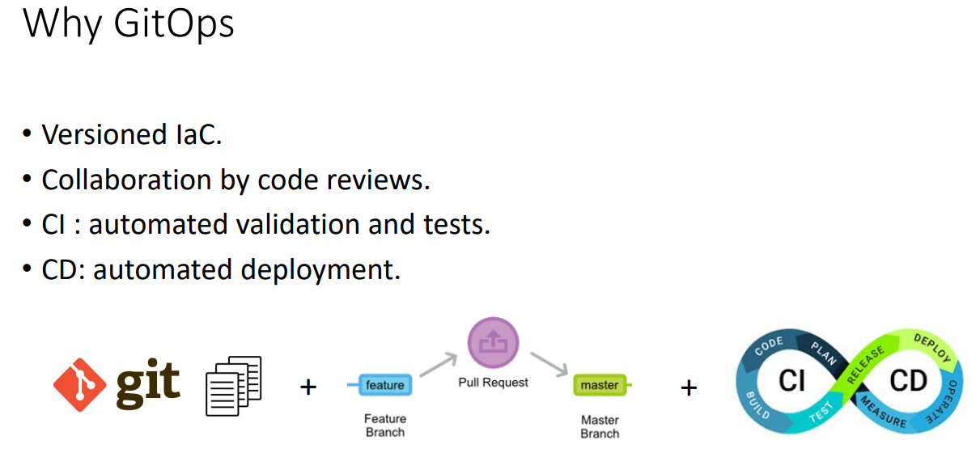

Slide 3
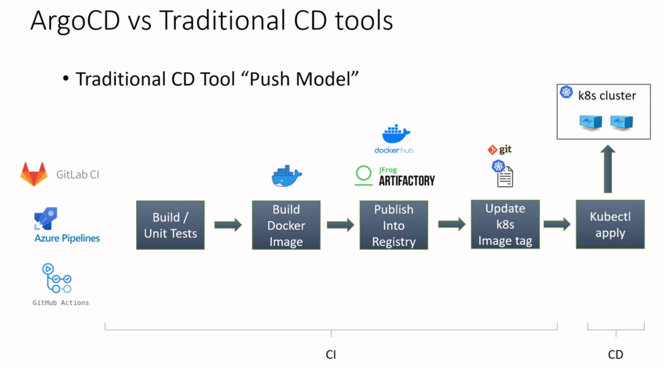

Slide 4
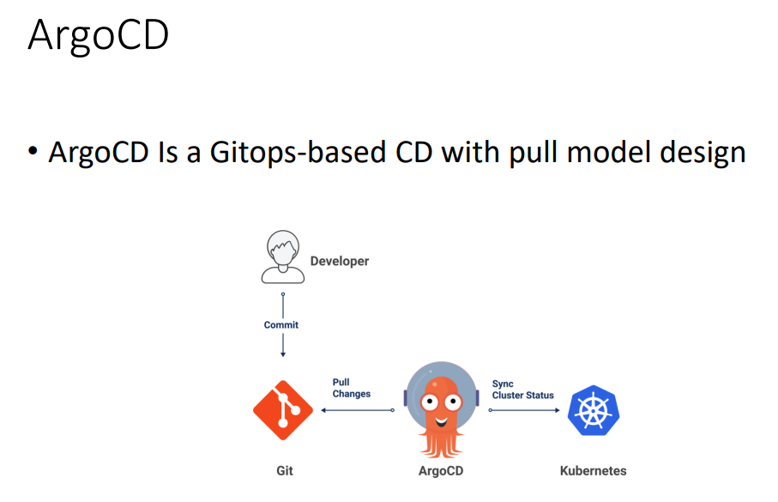
Notes:
• ArgoCD is a GitOps continues delivery tool for Kubernetes.
No AgroCD is not a CI tool

Slide 5
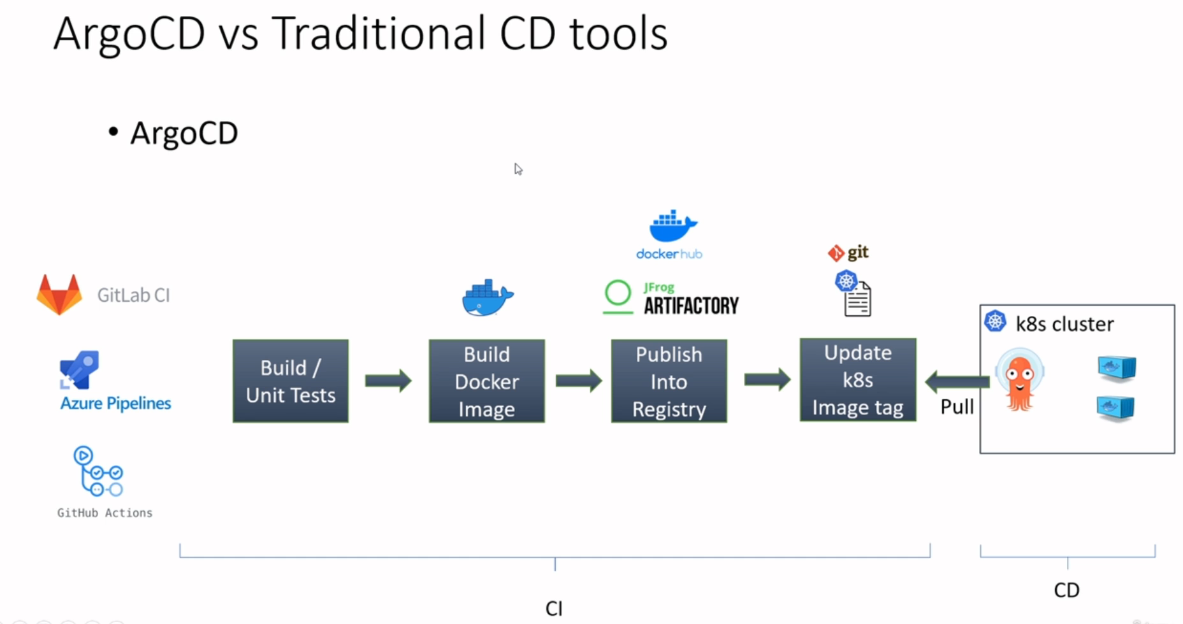
Notes:
• Git as the source of truth.
• Developer and DevOps engineer will update the Git code only.
• Keep your cluster in sync with Git.
• Easy rollback.
• More security: Grant access to ArgoCD only.
• Disaster recovery solution: You easily deploy the same apps to any k8s cluster.

Slide 6
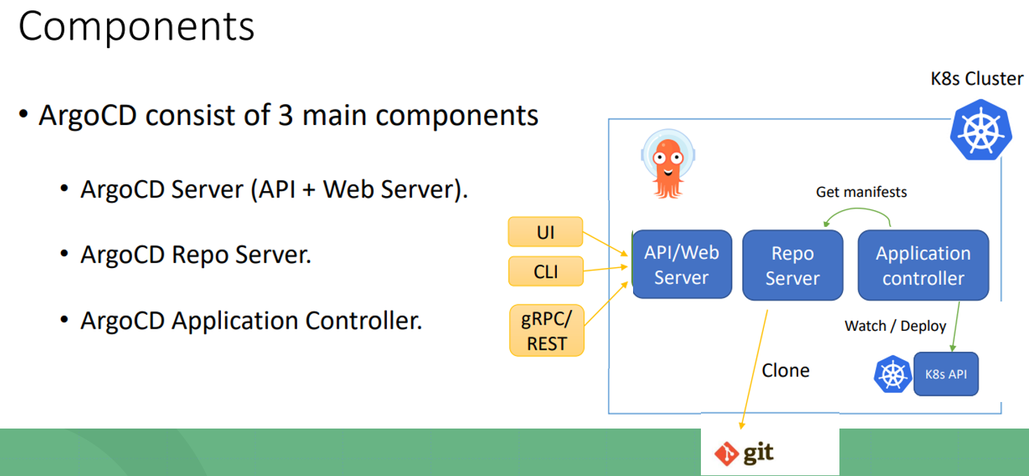
Notes:
kubectl create ns argocd
• Yaml Manifests : https://github.com/argoproj/argocd/blob/master/manifests/install.yaml
• Helm chart: https://github.com/argoproj/argohelm/tree/master/charts/argo-cd
Kubectl get secrets –m argocd argocd-initial-admin-secret –o yaml
kubectl port-forward svc/argocd-server -n argocd 8080:443
https://argo-cd.readthedocs.io/en/stable/cli_installation/

Slide 7
